Slide 1
Internet Security (CI6240)
Week 3 – Classical Cryptography
Dr Martin Tunnicliffe
M.J.Tunnicliffe@kingston.ac.uk
Dr Eckhard Pfluegel
E.Pfluegel@kingston.ac.uk

Slide 2
Teaching Block 1
Introduction
Mathematical Primer
Classical Cryptography
Digital Symmetric Ciphers
Public Key Cryptography
(Reading Week)
Cryptographic Hash Functions
Networks and Network-Based Attacks
Firewalls and Secure Architectures
Cryptography on the Internet
In-Class Test 1
TB1 Wrap-Up

Slide 3
Topics Covered
Terminology
Substitution Ciphers
  The Caesar Cipher
  Substitution with Keywords
  Random Ciphers
  Alternating (polyalphabetic) Ciphers
Transposition Ciphers
  Columnar Ciphers
  Cryptanalysis of Columnar Ciphers
Notes:
Here we are concerned with cryptography from its origins in antiquity, to the 1950s. Over this time, the main building blocks for many of the ciphers used in the digital age were developed. Next week we will start to look at stronger ciphers, of the sort used currently on the Internet.

Slide 4
A Quotation…
“…it may well be doubted whether human ingenuity can construct an enigma of the kind which human ingenuity may not, by proper application, resolve.”
Edgar Allan Poe, The Gold Bug, 1845.
Do you agree with this statement?
If so, see of you still agree with it after the next three weeks!

Slide 5
1.
Terminology

Slide 6
Cryptography
Cryptography: very popular and efficient “control”
Helps with confidentiality, integrity, authentication and non-repudiation
Formally, we can describe the situation as follows:
  Sender A (Alice) sends message to Recipient B (Bob) via a transmission medium T
    e.g. e-mail, HTTP message, Telnet session
  Eavesdropper E (Eve) wants to access message
  Eve might block, intercept, modify or fabricate messages
We want to keep the message secret and authenticated
  Eve cannot know what Alice is saying to Bob
  Eve cannot pretend to be Alice without Bob knowing it

Slide 7
Encryption and Decryption
Original message: plaintext P
  Convention: use capital letters
  e.g. SECRET MESSAGE
Encryption: converting plaintext into ciphertext C
  Convention: use small letters
  e.g. terces egassem
Decryption: gives original message
Alternative terms: to encode/decode, encipher/decipher
Notation:
  Encryption: C = E(P),
  Decryption: P = D(C).

Slide 8
Cryptography vs Cryptanalysis
Cryptography: the science of encryption
Cryptanalysis:
  Break an encryption – this is what attackers will do!
  Recognise patterns in encrypted messages
  Deduce the key
  Infer some meaning without even breaking the encryption
Breakable encryption: analyst can determine the algorithm (given enough time and data)
Cryptology is cryptography and cryptanalysis

Slide 9
Symmetric/Asymmetric Encryption
Algorithm: a set of instructions, performing certain computation
In our context: the encryption and decryption rules
  Practice: develop one reliable and “strong” encryption algorithm
  Can be open to public
  This uses then keys K, k₁, k₂ as input parameters – these must be kept safe
  Analogue: using mass-produced locks with individual keys

Slide 10
Types of Encryption
Symmetric encryption/decryption: same key:
  c = E(k, p), p = D(k, c)
Asymmetric encryption: different keys:
  c₁ = E(k₁, p), p = D(k₂, c₁), c₂ = E(k₂, p), p = D(k₁, c₂)
Two simple forms of symmetric encryption methods:
  Substitutions: replace characters
  Transpositions: rearrange characters
  A “product cipher” combines transposition and substitution
We will look at Substitution Ciphers first.

Slide 11
2.
Substitution Ciphers

Slide 12
Notations
We assume: plaintext message is given in ASCII characters
In this module we will use a simpler convention: A = 0, B = 1,.., Z = 25. (For an upper-case character we find the ASCII code by adding offset 65, and for lower case by adding offset 97. We ignore spacing and punctuation.)
Arithmetic is performed cyclically in “modulo 26” (mod 26):
0 1 2 3 4 5 6 7 8 9 10 11 12 13 14 15 16 17 18 19 20 21 22 23 24 25
“wrap around”
Notes:
ASCII = American Standard Code for Information Interchange
Represents letters, numbers, characters etc. as 7 or 8-bit words

Slide 13
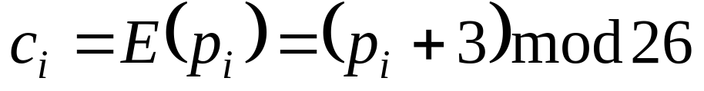
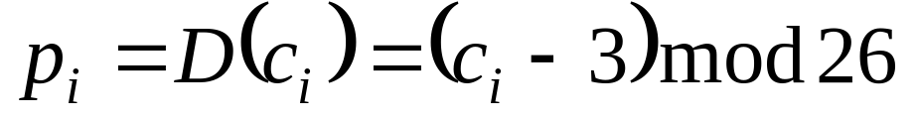
The Caesar Cipher
Classic example of a Substitution Cipher.
Named after the Roman general Julius Caesar (100-44BC) who used it for military communications.
The Caesar Cipher uses the following rule:
where
  p_{i} : alphabetical position of plaintext character i.
  c_{i} : alphabetical position of ciphertext character i.
E.g. “TREATY IMPOSSIBLE” becomes “wuhdwb lpsrvvleoh”
Rule to decipher:

Slide 14
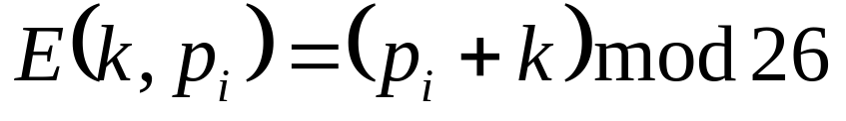
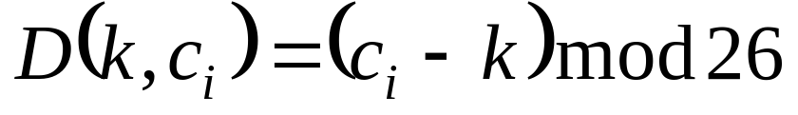
Advantages and Disadvantages
You needn’t shift by 3 characters (like Caesar did). You can use any “key” value k:
Advantages:
  Simple and easy to perform in the field
Disadvantages:
  Only 25 possibilities: vulnerable to a brute-force attack!
Notes:
A “brute force” attack is an attack in which all possibilities are tried sequentially until the correct key is found.

Slide 15
Brute-Force Attack on Caesar Cipher
Cyphertext: dro zkccgybn sc ckeckqoc
k=1: CQN YJBBFXAM RB BJDBJPNB
k=2: BPM XIAAEWZL QA AICAIOMA
k=3: AOL WHZZDVYK PZ ZHBZHNLZ
k=4: ZNK VGYYCUXJ OY YGAYGMKY
k=5: YMJ UFXXBTWI NX XFZXFLJX
k=6: XLI TEWWASVH MW WEYWEKIW
No luck yet...☹

Slide 16
Brute-Force Attack on Caesar Cipher
k=7: WKH SDVVZRUG LV VDXVDJHV
k=8: VJG RCUUYQTF KU UCWUCIGU
k=9: UIF QBTTXPSE JT TBVTBHFT
k=10: THE PASSWORD IS SAUSAGES
Success!!!! ☺
We must get it in 25 tries or less!

Slide 17
Use of words as keys
We could use a word as a key: e.g.
ABCDEFGHIJKLMNOPQRSTUVWXYZ
...
wordabcefghijklmnpqstuvxyz
So here: E(A) = w, E(B) = o, ..., E(Z) = z
Example: SECRET is encrypted to qarpas
But… why not go a step further and use a totally random substitution?
This would require a long (25-character) key, but would the code not be unbreakable?
Notes:
If you read the stories by Poe and Conan Doyle you will already know the answer to the last question.

Slide 18
Random Substitution Cipher
Plain | Cipher | Plain | Cipher | Plain | Cipher
A | p | J | f | S | e
B | h | K | n | T | o
C | t | L | q | U | x
D | i | M | b | V | y
E | m | N | u | W | a
F | s | O | l | X | k
G | c | P | d | Y | z
H | w | Q | v | Z | j
I | r | R | g
bmmo po briurcwo = MEET AT MIDNIGHT
Could this ever be deciphered without the key?

Slide 19
Strength of Random Substitutions
Admittedly the key is long (25 characters)
At first glance, cracking a random cipher may seem virtually impossible.
The number of possible keys is:
(The “!” is pronounced “factorial”)
Four and twenty three zeros!!!!
However, it is easier than it seems…

Slide 20
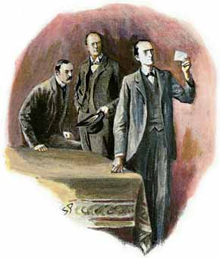

A Quote from Sherlock Holmes
“You wrote it? There was no one on earth outside the Joint who knew the secret of the dancing men. How came you to write it?”
“What one man can invent another can discover,” said Holmes.
Sir Arthur Conan Doyle, The Return of Sherlock Holmes, 1905.

Slide 21
How is this possible?
PRESERVATION OF LETTER FREQUENCIES:
  For example: letter “E” most frequent letter in English
  Therefore: look for most frequent symbol in ciphertext
    This will almost certainly represent “E”!
  The longer the ciphertext is, the better this method works
PRESERVATION OF PATTERNS:
  Short words, repeated patterns give clues for guessing substitutions

Slide 22
Letter Frequencies
Letter | %age | Letter | %age | Letter | %age
A | 8.2 | J | 0.1 | S | 6.3
B | 1.5 | K | 0.8 | T | 9.0
C | 2.8 | L | 4.0 | U | 2.8
D | 4.2 | M | 2.4 | V | 1.0
E | 12.7 | N | 6.7 | W | 2.4
F | 2.2 | O | 7.5 | X | 2.0
G | 2.0 | P | 1.9 | Y | 0.1
H | 6.1 | Q | 0.1 | Z | 0.1
I | 7.0 | R | 6.0
(From Wikipedia: slightly different versions exist across the web. You can do your own analysis online: http://www.counton.org/explorer/codebreaking/frequency-analysis.php)

Slide 23
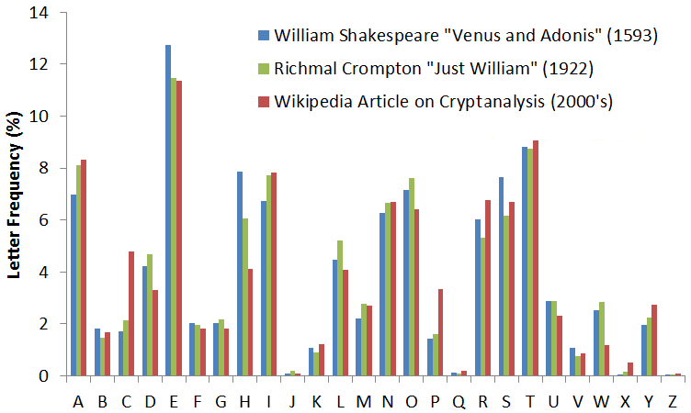
Different Types of Literature

Slide 24
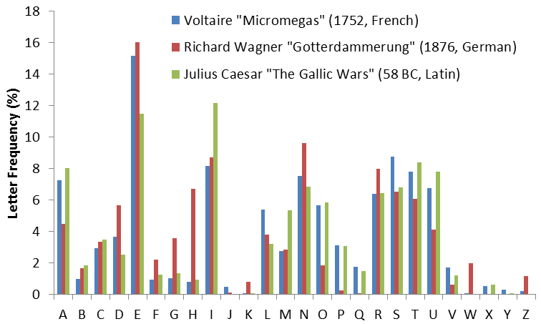
Different Languages

Slide 25
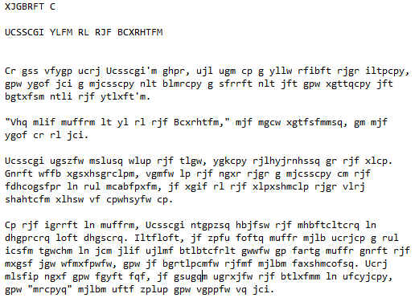
Example: Random Ciphertext

Slide 26
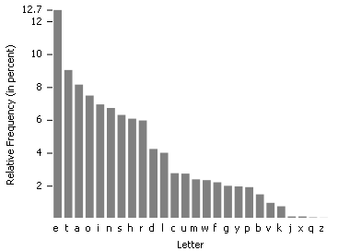
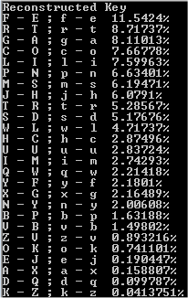
Letter Frequencies

Slide 27
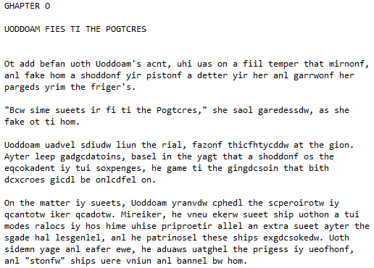
Reconstructed Plaintext

Slide 28
How Can We Improve This?
PRESERVATION OF PATTERNS: Short words, repeated patterns give clues for guessing substitutions
Substitution Guesses:
befan = began?
(f→g)
sueets = sweets?
(u → w)
saol = said?
(o → i, l → d)

Slide 29
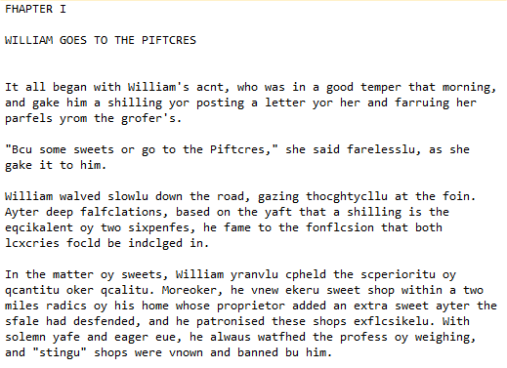
Improved Reconstruction

Slide 30
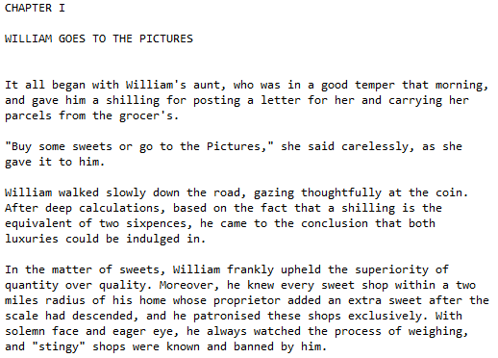
A few more guesses…

Slide 31
So What Next?
If even random substitutions are vulnerable, what can we do to make ciphers secure?
All the ciphers we have considered so far have a common weakness:
  The mapping is invariant: every ciphertext character always represents the same plaintext character.
We can eliminate this problem using an “alternating” (or “polyalphabetic”) cipher:
  An example is the Vigenére cipher…

Slide 32
Vigenére Cipher
Choose a key: It could be a word of a sentence.
The length of the key is called the period n.
Key letters are used to “shift” plaintext letters
Implemented using a table (“tableau”)
This implements 26 different substitutions
Method: c_{i} = (p_{i} + k_{i} _{mod n}) mod 26
  Suffix i represents the position of the character within the message and within the key word.

Slide 33
Vigenére Tableau
0
1
2
25
 | a | b | c | ... | z
A | a | b | c |  | z
B | b | c | d |  | a
:
Z | z | a | b |  | y
0
1
25
This is nothing more than a tabular representation of all 26 possible Caesar ciphers. (Shown here only in part.)

Slide 34
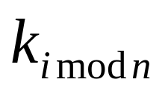


Vigenére Encryption
 | a | b | c | ... | z
A | a | b | c |  | z
B | b | c | d |  | a
:
Z | z | a | b |  | y
For each character:
1. Look up next plaintext letter on right
2. Follow row to where it intersects the column corresponding to the next character in the key.

Slide 35
Vigenére Decryption
 | a | b | c | ... | z
A | a | b | c |  | z
B | b | c | d |  | a
:
Z | z | a | b |  | y
For each character:
1. Find column for next character in key.
2. Find next ciphertext character in column and read off plaintext to the right.

Slide 36
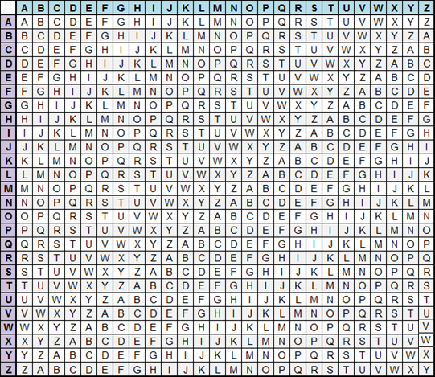
Vigenére Tableau: Example
Plaintext: WHAT A LOVELY DAY
Key: PURPLE
Period n=6
Extend key to length of plaintext: PURP L EPURPL EPU
Ciphertext:
lbri l pdpvaj hps

Slide 37
Cryptanalysis of Vigenère Cipher
Vigenère was once considered unbreakable
However repetitions can give clues about period
There are some interesting online tools for analysing Vigenère ciphers.
Try checking out:
  http://www.mygeocachingprofile.com/codebreaker.vigenerecipher.aspx
  http://www.simonsingh.net/The_Black_Chamber/vigenere_cracking_tool.html

Slide 38
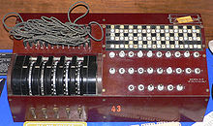
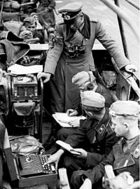
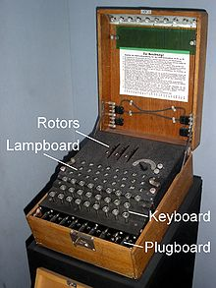
Another Famous Alternating Cipher
A well known alternating cipher was the “Enigma” code used by Nazis during World War II.
  There is an online Enigma simulator you can try at http://enigmaco.de/enigma/enigma.html
  The code was eventually beaten by British and Polish cryptanalysts – most notably Alan Turing – “the Bombe”
Notes:
“The Bomb” was a huge electromechanical computer used to decrypt codes. It got its name because of the clicking noise it made, like that of a time bomb. (Not to be confused with the atomic bomb.)

Slide 39
3.
Transposition Ciphers

Slide 40
Transposition Ciphers
Rearrangement characters of message, without replacing them. (Sometimes called a “Permutation Cipher”.)
Principle is known as “diffusion”.
  Substitution ciphers use principle of “confusion”.
Substitutions and transpositions more effective if both are combined
Combination of two ciphers is called a “Product Cipher”
  Not necessarily stronger than individual ciphers, e.g. combining the Caesar Cipher with itself simply produces another Caesar cipher
  However a “Feistel network” - a repeated combination of transposition and substitution first proposed by Claude Shannon - does make strong ciphers (like DES).

Slide 41
Columnar Transpositions
This method rearranges plaintext by rows/columns
Example:
THIS IS A SECRET MESSAGE
Arranged in rows (ignoring word separations):
T H I S
I S A S
E C R E
T M E S
S A G E
Reading by columns, the resulting ciphertext is
tietshscmaiaregssese
Omitting spaces makes ciphertext even less readable

Slide 42
Cryptanalysis
Transpositions might look less secure than substitutions, but can in fact be more secure
Main difference: plaintext letters are left intact
Letter frequency tables:
  Do not break code
  If all letters in cipher text appear with their normal frequencies, it is likely that transposition cipher has been used

Slide 43
Bigram Frequencies
Bigram | %age | Bigram | %age
TH | 3.15 | HE | 2.51
AN | 1.72 | IN | 1.69
ER | 1.54 | RE | 1.48
ES | 1.45 | ON | 1.45
EA | 1.31 | TI | 1.28
AT | 1.24 | ST | 1.21
EN | 1.20 | ND | 1.18
Bigram and trigram frequency tables
Give frequencies of groups of two/three letters.
This can be used in order to break ciphertext into columns.

Slide 44
Using Bigram Frequencies
Likely Bigram?
(Pr(TH)=3.15%)
Next Two Letters?
tietshscmaiaregssese
5
5
5
Difficult to do in practice…
A lot of false leads may need to be followed

Slide 45
Summary
Cryptological terminology and notation
Substitution ciphers
  Caesar cipher
  Use of keywords → Random cipher
  Polyalphabetic ciphers
  Vigenère Cipher
  Enigma Cipher vs. “The Bombe”
Transposition ciphers
  Columnar ciphers

Slide 46
Overall Conclusions
Simple substitution ciphers are not secure.
Alternating ciphers are stronger but still breakable.
  Example: Vigenère cipher is particularly vulnerable when key-size is small compared to the message.
  Why not make the key size infinitely long? (One Time Pad)
Transposition ciphers can be strong, but still breakable by pattern searching.
Next Week: modern “Compound Ciphers” combining substitution and transposition: DES and AES.

Slide 47
Homework
Do the Online Quiz
Do the “Cryptanalysis Challenge” homework exercise
Watch the following YouTube videos…
  …about the DES Algorithm: https://www.youtube.com/watch?v=3BZRBfhpIb0
  and the Simplified DES Algorithm https://www.youtube.com/watch?v=qHZKze24kVo
Optional: You may also find this video on the NSA interesting: https://www.youtube.com/watch?v=2MWS1UAvZLg

